Slide 1
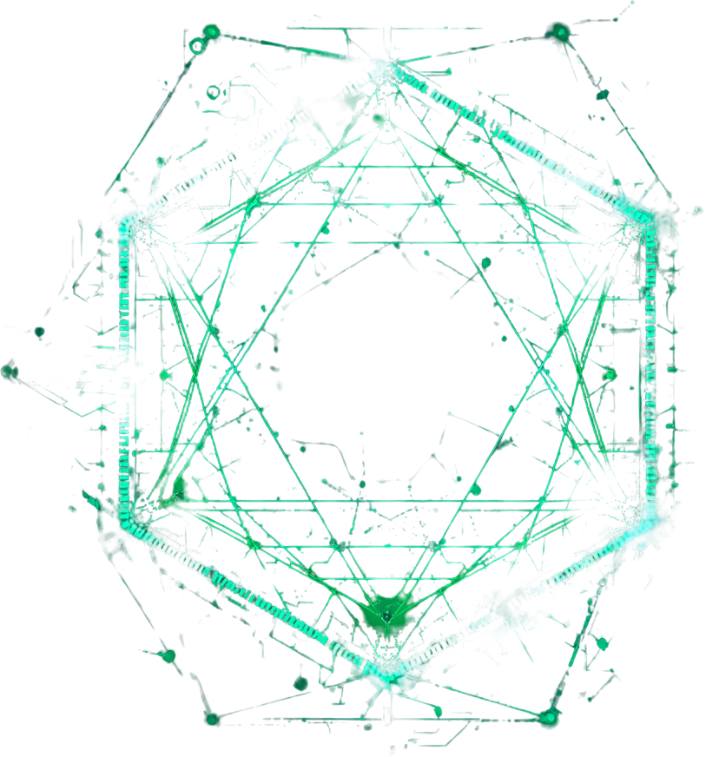
Project Overview
Objectives
Methodology
AI Integration
HUST, Vietnam
Advanced Iron-Based Lithium Battery Electrodes: AI-Driven Development and Performance Prediction

Slide 2
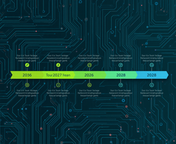

Project Overview
Funding & Team
Timeline
Objectives
HUST Research
Project
Information
Team member
Professor and Advisor
Nguyen Quoc Khanh - HUST - Material development
Ta Duc Hien - HUST - AI engineer
Joeng Jueun - Battery Test Engineer
Mun Jihyun - AI engineer
Prof. Nguyen Xuan Dien - HUST
Prof. Kang Jungwon - Mokpo University

Slide 3

Background of the study
Problem Statement
Framework
Methodology
Hanoi Univ. of Sci. & Tech.
02
Project Summary
Proposed Solution
The MSxOySez shell (15–20 nm) encapsulates the SiOx core, forming a Built-in Electric Field (BIEF) that accelerates Li+ transport, absorbs mechanical stress, and stabilizes the electrode structure over hundreds of charge-discharge cycles.
01
Core Challenge
The AI Co-Scientist workflow treats each electrode sample as an experimental recipe. Process conditions, SEM-derived morphology features, EDX composition, and electrochemical results are merged by sample_id into a master dataset. The MVP learns from previous samples, predicts capacity retention, and recommends the top next fabrication recipes for human review.

Slide 4
Background of the study
Problem Statement
Framework
Methodology
Hanoi Univ. of Sci. & Tech.
Project Summary
MSxOySez/SiOx heterostructured composites (M = Fe or Nb) are engineered as high-capacity anodes. SiOx delivers >1500 mAh/g — approximately 4× graphite (372 mAh/g) — making it a transformative candidate for next-generation Lithium-ion batteries.
01
02
Core Challenge
Proposed Solution
SiOx anodes suffer from >300% volume expansion during lithiation and delithiation cycles. This causes severe electrode cracking, rapid capacity fade, and structural degradation — limiting commercial viability despite exceptional theoretical capacity.
The MSxOySez shell (15–20 nm) encapsulates the SiOx core, forming a Built-in Electric Field (BIEF) that accelerates Li+ transport, absorbs mechanical stress, and stabilizes the electrode structure over hundreds of charge-discharge cycles.

Slide 5

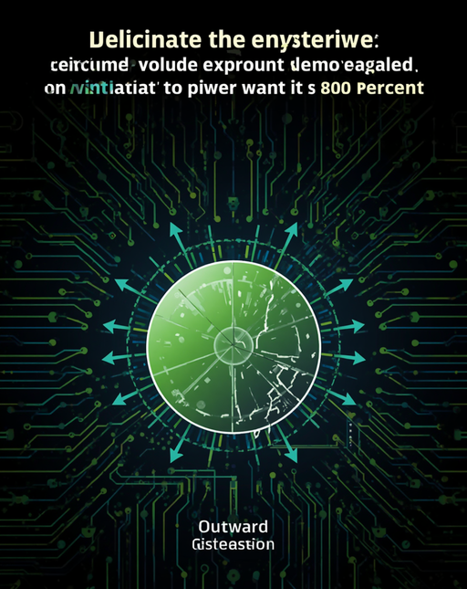
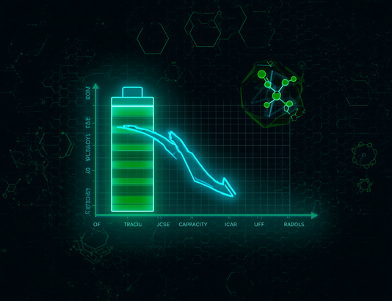
Technical Challenges
Problem Statement
Framework
Methodology
Larana Company
Technical
Challenges
of SiOx Anodes
SiOx anodes deliver exceptional specific capacity exceeding 1500 mAh/g — approximately 4x that of conventional graphite (372 mAh/g). However, this high capacity comes with a critical drawback: volume expansion greater than 300% during lithiation cycles, causing severe mechanical stress and structural cracking.
Repeated expansion and contraction leads to rapid capacity fade, electrode pulverization, and loss of electrical contact. These degradation mechanisms severely limit cycle life and Coulombic efficiency, making mechanical and electrochemical stabilization the central engineering challenge for next-generation SiOx-based anodes.

Slide 6
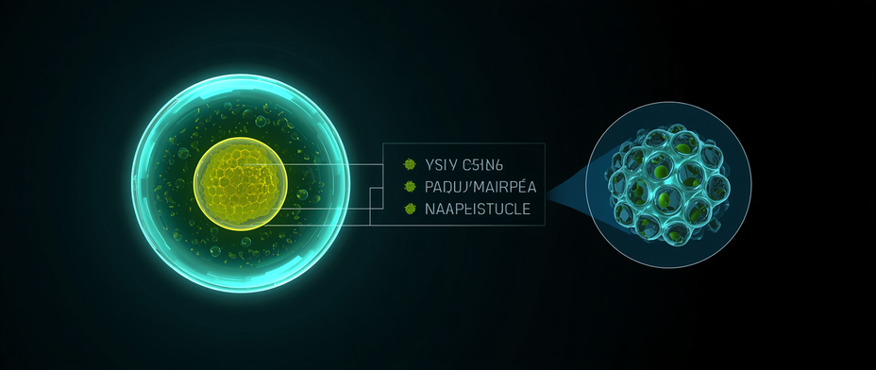
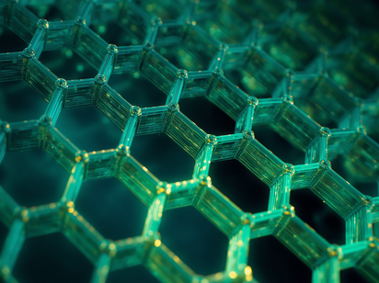


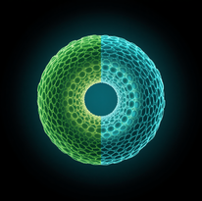
Background of the study
Problem Statement
Framework
Methodology
Hanoi University of Science and Technology
01
SiOx Core (80–120 nm)
High-capacity active material >1500 mAh/g
Heterostructure
Composite Solution
02
MSxOySez Shell (15–20 nm)
Mechanical protection, conductivity & BIEF
MSxOySez/SiOx yolk-shell and honeycomb porous architecture delivers high capacity with structural stability. The synergistic core-shell design buffers volume expansion while accelerating Li-ion transport via Built-in Electric Field (BIEF).
03
30–40% Void Space
Absorbs >300% volume expansion during cycling

Slide 7
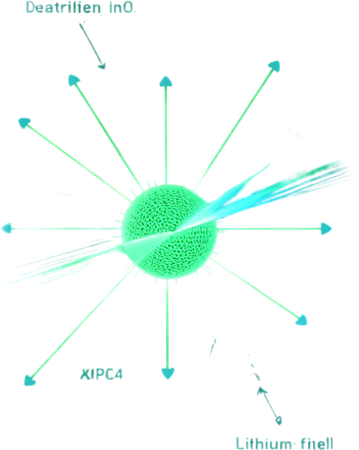
Background
Technical Challenges
Composite Solution
BIEF Mechanism
HUST Research
Built-in Electric Field (BIEF) Mechanism
The MSxOySez shell layer generates a Built-in Electric Field (BIEF) at the heterostructure interface. This internal field dramatically accelerates Li+ ion transport kinetics, reduces charge transfer resistance, and stabilizes the composite structure by absorbing mechanical stress during repeated lithiation and delithiation cycles.
01
02
Li+ Ion Transport Enhancement
Structural Stress Stabilization
The BIEF originates from the MSxOySez/SiOx heterojunction interface, creating a directional electric field. This field lowers the energy barrier for Li+ diffusion, boosting ion transport efficiency by up to 3x compared to conventional SiOx anodes, enabling superior rate capability and fast-charging performance at 5.0C.
The BIEF actively counteracts the >300% volume expansion of SiOx during cycling. By distributing mechanical stress across the MSxOySez shell (15-20 nm thick) and the 30-40% void buffer space, the composite maintains structural integrity over 500+ cycles, preventing crack formation and capacity fade.

Slide 8

Background of the study
Problem Statement
AI Applications
Methodology
Hanoi Univ. of Science & Technology
01
Data Inputs
Process CSV
03
AI
Applications
GP/UCB
Ranking
02
04
EDX + Electrochemistry
Master
Dataset
05
07
SEM
Features
Top-3
Recipes
Pipeline: raw process, SEM, EDX, and electrochemistry CSVs are merged into a master dataset. A RandomForest baseline and Gaussian Process surrogate predict retention_100. Candidate recipes are ranked by GP/UCB, then the researcher accepts, modifies, or rejects the top-3 suggestions.
06
08
retention_100
Prediction
Human
Review

Slide 9
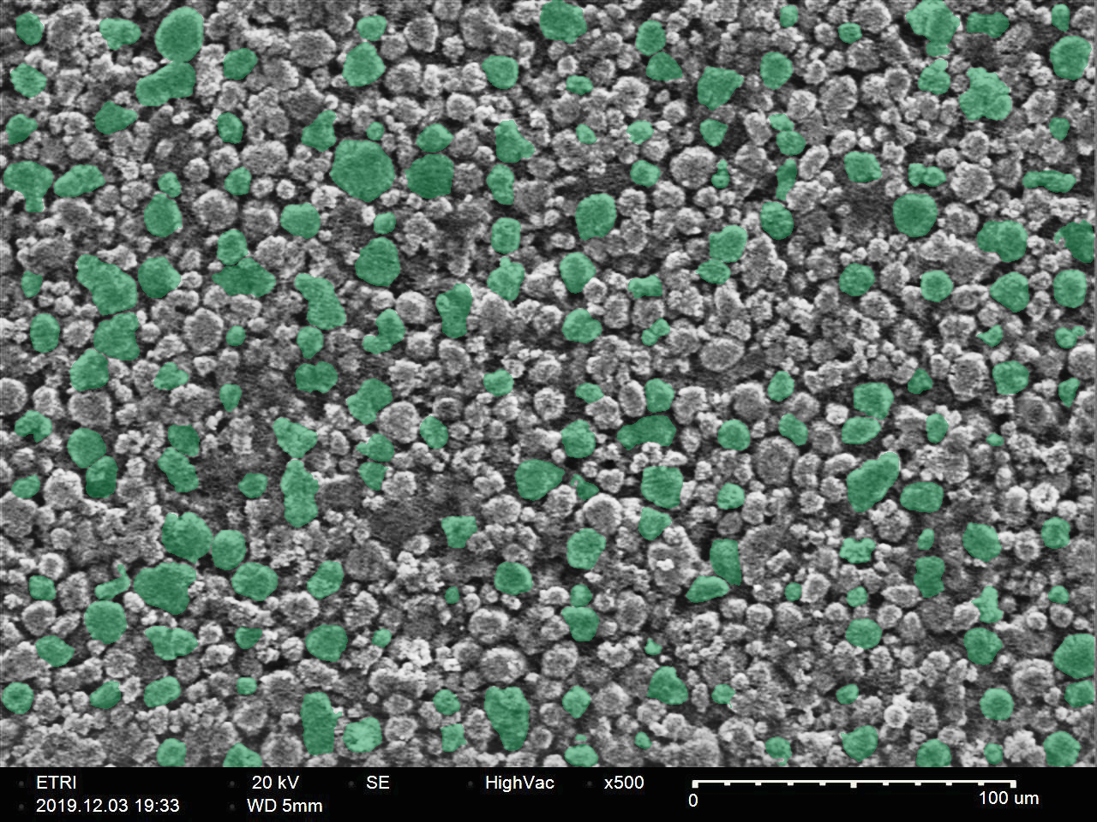
SEM Feature Extraction
Problem Statement
Framework
Methodology
Larana Company
SEM-Derived
Morphology
The shown SAM overlay is a tested visual route for segmentation. In the MVP, simple ImageJ/OpenCV/scikit-image features are enough; SAM/SAM2 can be used later when the dataset and labeling workflow are mature.
SEM images are converted into lightweight morphology features: particle size, porosity score, agglomeration index, crack density, and surface uniformity. These descriptors tell the model what the electrode microstructure looks like.

Slide 10
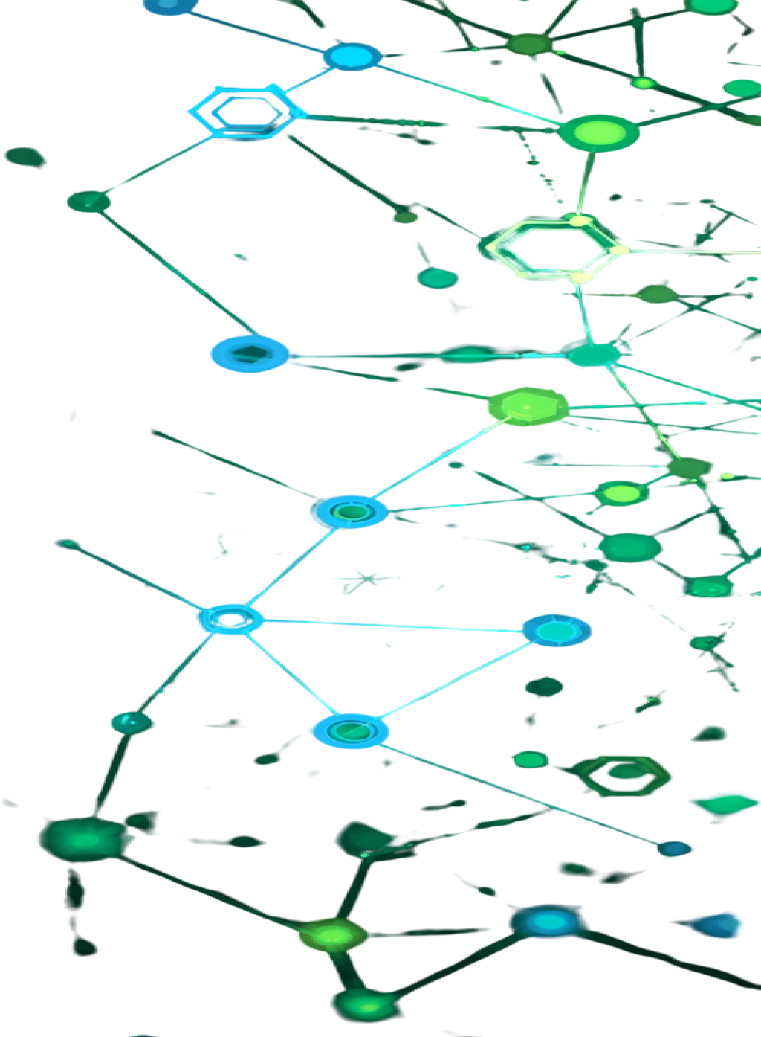
Background of the study
Problem Statement
AI Applications
ML Models
HUST Research
Modeling Recipe-to-Retention Relationship
The MVP uses a RandomForest regressor as the explainable baseline and a Gaussian Process surrogate for uncertainty-aware ranking. Electrochemical results provide the training target; recommendation-time features must avoid target leakage.
01
02
Input Features
Prediction Target
Model input features:
- Fabrication recipe: Si, MXene, alginate, carbon, mixing time, drying temperature, pressing pressure.
- SEM features: particle size, porosity, agglomeration, crack density, surface uniformity.
- EDX features: Si, Ti, C, O, impurity percentage and derived ratios.
Model outputs and use:
- Predict retention_100 as the main target.
- Estimate which recipes may lose capacity quickly.
- Produce feature importance for explanation.
- Feed candidate predictions into the recommendation engine.

Slide 11

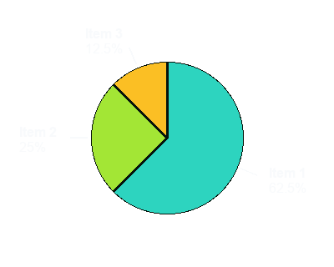
Top-3 Recipe Recommendation
AI Co-Scientist
Framework
Methodology
Larana Company
Top-3
Recipes
The recommender builds a constrained recipe grid, removes recipes already tested, predicts retention_100 for each candidate, and ranks new candidates with a GP/UCB score that balances expected performance and uncertainty.
Top 3
Output is not an autonomous decision. The dashboard shows rank, recipe parameters, predicted retention, confidence, and reason; the researcher chooses Accept, Modify, or Reject.

Slide 12
Background of the study
Problem Statement
Framework
Methodology
Hanoi University of Science and Technology
01
Specific Capacity
≥1450 mAh/g @ 0.1C
03
Technical
Performance
Targets
Cycle Retention
≥80% after 500 cycles
02
04
Initial Coulombic
Efficiency ≥82.5%
Fast Charging
≥600 mAh/g @ 5.0C
05
07
Model Target
retention_100
Rate Performance
≥1000 mAh/g @ 2.0C
AI success is measured by the runnable workflow: master_dataset.csv, trained_model.pkl, model_metrics.json, feature_importance.csv, recommendations.csv, and a Streamlit dashboard. Synthetic/sample data demonstrate the logic only; scientific claims require real lab data.
06
08
Deliver 2 kg
Finished Powder
Coulombic Efficiency
≥99% after 10 cycles

Slide 13
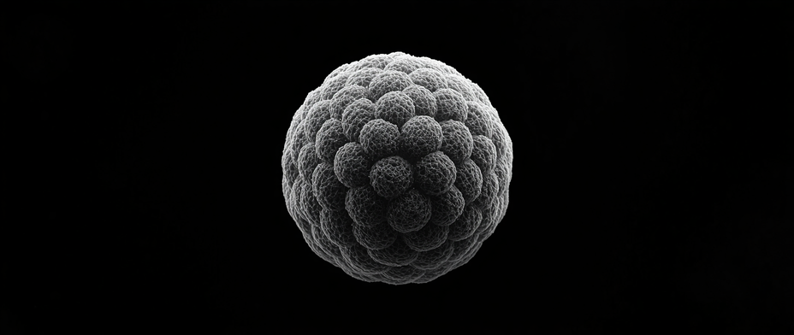
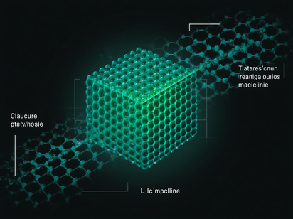


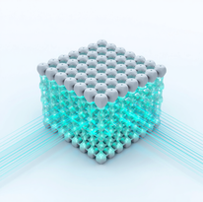
Background of the study
Problem Statement
Framework
Methodology
Hanoi University of Science and Technology
01
SiOx Core: 80–120 nm
Capacity >1500 mAh/g (~4× graphite)
Scientific
Basis
02
MSxOySez Shell: 15–20 nm
Mechanical protection + electrical conductivity
The MSxOySez/SiOx composite adopts a yolk-shell or honeycomb porous architecture engineered at the nanoscale to deliver high capacity, structural stability, and efficient ion transport for next-generation Li-ion battery anodes.
03
30–40% Void Space
Buffers >300% volume expansion during cycling

Slide 14
Project Overview
Technical Approach
AI Integration
Manufacturing
HUST Research
Manufacturing Process Overview
A four-step synthesis process transforms raw precursors into high-performance MSxOySez/SiOx heterostructured composite anode materials. Each step is precisely controlled for temperature, duration, and chemical environment to ensure optimal nanostructure formation.
Step 1
Step 2
Step 3
Step 4
Magnesiothermic Reduction: Synthesis of porous SiOx nanoparticles (80–120 nm)
Metal Hydroxide Adsorption: FeCl3 or NbCl5 precursor adsorption and precipitation onto SiOx surface
Hydrothermal Reaction: Crystallization and nanostructure formation of the composite shell
Sulfurization & Selenization: Conversion to MSxOySez heterostructure shell
Conditions: 650°C, 3 hours under inert atmosphere. Produces high-surface-area porous SiOx core structure.
Controlled pH precipitation forms uniform metal hydroxide shell layer (15–20 nm) on SiOx core particles.
Conditions: 180°C, 12 hours in autoclave. Develops yolk-shell morphology with 30–40% void space.
Conditions: 550–600°C, 3–4 hours. H2S/H2Se gases fully recovered. Final MSxOySez/SiOx composite powder delivered.

Slide 15
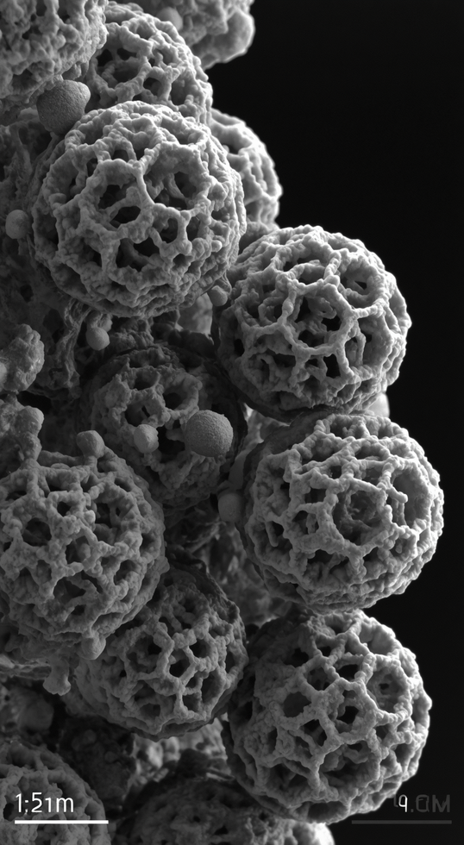
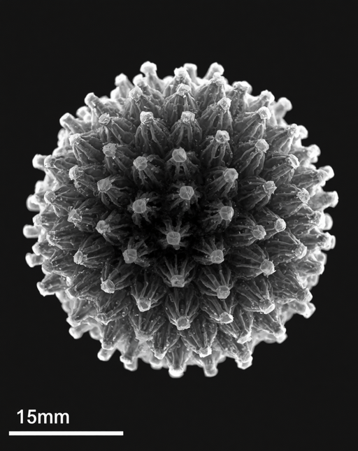
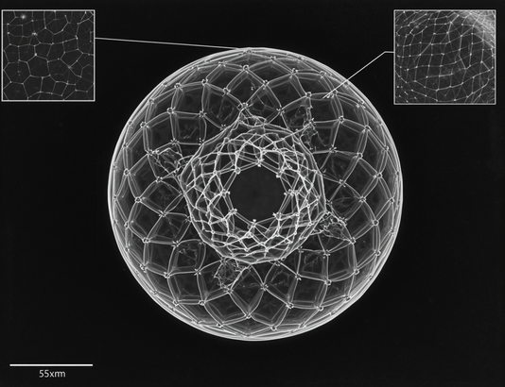
Background of the study
Problem Statement
Framework
Methodology
Larana Company
SEM/TEM
Micrographs
Fig. 1: SEM image of yolk-shell MSxOySez/SiOx composite. Scale bar: 200 nm. The porous honeycomb architecture and uniform shell coating are clearly visible, confirming 30–40% void space for volume expansion buffering.
Fig. 2 & 3: TEM images showing MSxOySez shell uniformity (15–20 nm thickness) around SiOx core (80–120 nm). The distinct core-shell interface confirms successful heterostructure formation and structural integrity.

Slide 16

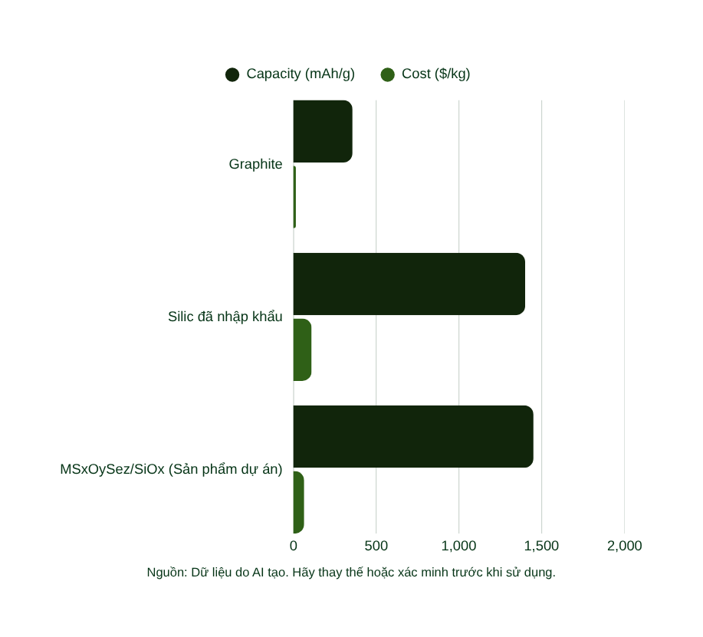
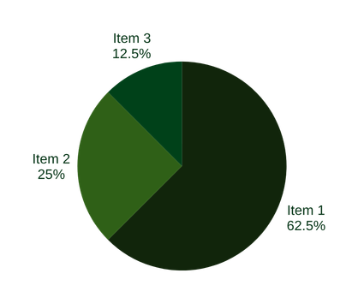
Background of the study
Problem Statement
Framework
Methodology
Larana Company
Competitor Performance & Cost Comparison
Our MSxOySez/SiOx composite achieves 1400-1500 mAh/g at $55-75/kg — outperforming graphite by 4x and undercutting imported silicon by ~40% in cost. A compelling balance of high capacity and commercial viability.

Slide 17


Background of the study
Target Markets
Framework
Methodology
Hanoi University
Target
Markets
Electric Vehicles (EV)
Energy Storage Systems
3C Electronics
Primary market for high-capacity anodes. Key customers include VinFast and emerging Vietnamese EV manufacturers. MSxOySez/SiOx enables longer range and faster charging, directly supporting Vietnam's EV transition and Southeast Asia's growing automotive electrification.
VinES and regional grid-scale storage operators demand durable, high-cycle-life anodes. Our composite materials deliver ≥80% capacity retention after 500 cycles, making them ideal for renewable energy storage infrastructure across Southeast Asia.
Smartphones, laptops, and wearables require compact, high-density energy storage. Our anode materials offer 4x the capacity of graphite, enabling slimmer, longer-lasting consumer devices for the fast-growing Southeast Asian electronics market.

Slide 18

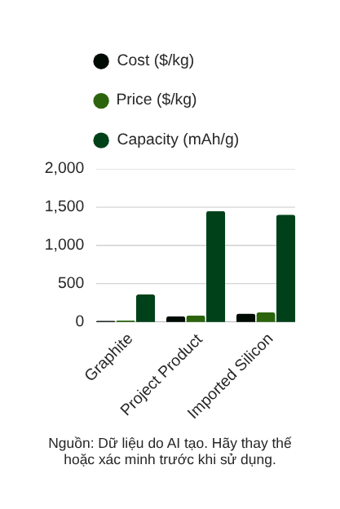
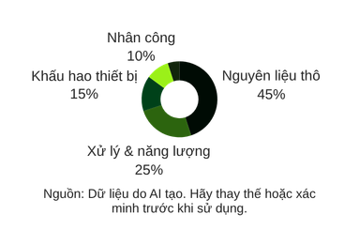
Cost Structure
Pricing Strategy
Financials
Commercialization
HUST Research
Production Cost
& Pricing
Pilot production at 10 tons/year scale. Production cost is $75/kg, with a proposed selling price of $85/kg — delivering a strong profit margin of 35.3%. This positions the project competitively against imported silicon anode materials priced at $90–$130/kg.
35.3%
Profit margin vs. imported silicon at $90–$130/kg. Project cost: $75/kg. Sell price: $85/kg.

Slide 19

Market Overview
Growth Drivers
EV Adoption
Forecast 2030
Hanoi University of Science and Technology
$500M USD
By 2030
Vietnam's battery material market is projected to exceed $500 million USD by 2030, driven by rapid EV adoption, energy storage expansion, and localization of Lithium-ion battery supply chains across Southeast Asia.
Presented By:
Assoc. Prof. Dr. Nguyen Van A

Slide 20
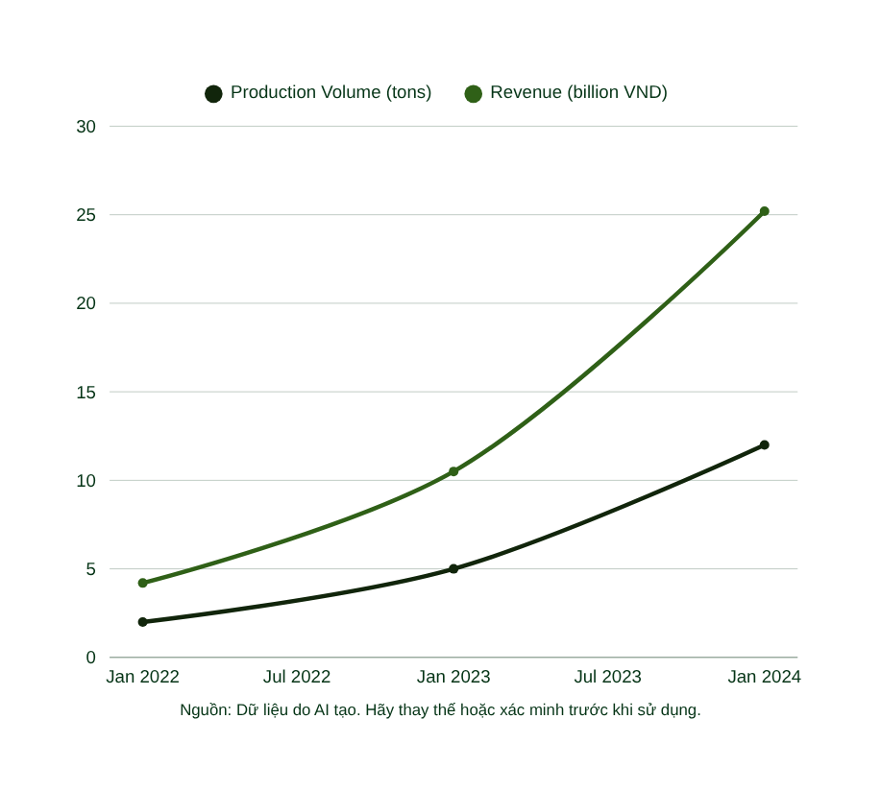
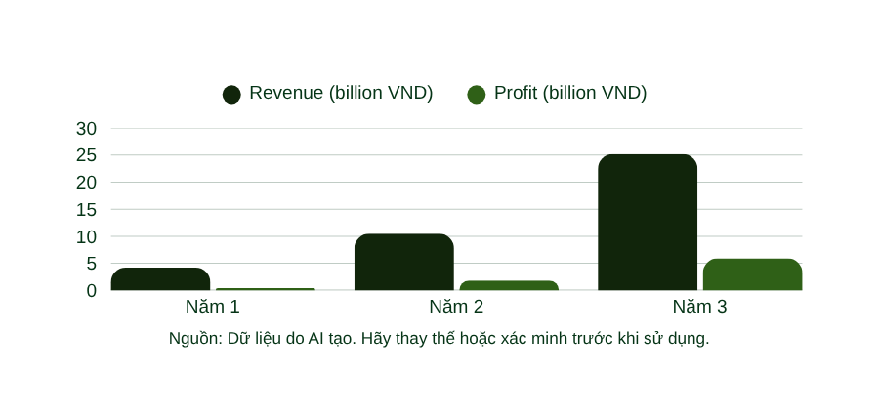
Background of the study
Problem Statement
Framework
Methodology
Larana Company
Three-Year Financial Forecast
Production scales from 2 tons (Year 1) to 12 tons (Year 3), with revenue growing from 4.2B to 25.2B VND. Profit margin improves significantly as operations scale, reaching 5.92B VND by Year 3 — demonstrating strong commercial viability.

Slide 21
Background of the study
Problem Statement
Framework
Methodology
Larana Company
01
Proprietary
Heterostructure
03
Competitive
Advantages
Lower Cost vs.
Imported Silicon
02
04
AI Co-Scientist
Workflow
Superior Battery
Performance
05
07
Scalable Pilot
Production
Local Market
Leadership
MSxOySez/SiOx heterostructured composites deliver a unique combination of high capacity (≥1450 mAh/g), structural stability, and cost efficiency — positioning this project as a leading domestic alternative to expensive imported silicon anode materials for next-generation Lithium-ion batteries.
06
20
Eco-Friendly
Manufacturing
Strong R&D
Foundation

Slide 22


Background of the study
Problem Statement
Framework
Methodology
Larana Company
Technological
& Environmental Impact
Heterostructure Mastery
Emission Recovery
Carbon Reduction
The AI contribution is a practical lab decision-support loop: merge process, SEM, EDX, and electrochemical data; learn recipe-performance relationships; recommend top next experiments; and feed new lab results back into the dataset.
Manufacturing process achieves 100% recovery of hazardous H2S and H2Se gas emissions through closed-loop scrubbing systems, ensuring a safe, compliant, and environmentally responsible production environment.
Localized production of high-performance anode materials significantly reduces carbon emissions versus imported alternatives, supporting Vietnam's green energy transition and sustainable industrial development goals.

Slide 23



Background of the study
Problem Statement
Social Impact
Methodology
Hanoi University of Science and Technology
Social Impact Areas :
Social Impact
Employment & Workforce
High-Tech Job Creation
Skilled workforce in battery R&D and manufacturing
This project generates meaningful social benefits by creating high-tech employment, localizing advanced battery manufacturing in Vietnam, and accelerating the nation's transition to clean, sustainable green energy solutions.
Industrial Localization
Localization of Li-ion
Battery Production in Vietnam
Key Social Benefits
Creation of High-Tech Jobs in Vietnam
Localization of Li-ion Battery Production
Support for Green Energy Transition
Clean Energy
Green Energy Transition
Sustainable development support

Slide 24
Background of the study
Problem Statement
Framework
Methodology
Larana Company
Research Implementation Roadmap
Implementation roadmap for the AI Co-Scientist MVP: build clean CSV schemas, merge data by sample_id, train retention_100 models, generate top-3 recipe recommendations, expose results in Streamlit, and update the model after new experiments.
Months 1–6
Months 7–12
Months 13–18
Months 19–24
Phase 1: Synthesis of porous SiOx via magnesiothermic reduction; initial composite fabrication and structural characterization
Phase 2: Train RandomForest baseline and Gaussian Process surrogate for retention_100; save metrics, model bundle, and feature importance
Phase 3: Build Streamlit dashboard showing dataset overview, model metrics, feature importance, and top-3 AI recommendations
Phase 4: Fabricate selected recipes, collect SEM, EDX, and electrochemical results, then append new data to the next training round
Phase 1 (cont.): Prepare process_data.csv, sem_features.csv, edx_data.csv, and electrochem_data.csv; build master_dataset.csv by sample_id
Phase 2 (cont.): Generate candidate recipes, remove already-tested recipes, rank top-3 suggestions by GP/UCB score and confidence
Phase 3 (cont.): Add Accept / Modify / Reject decision placeholders for human-in-the-loop experimental planning
Phase 4 (cont.): Keep claims limited to decision support until enough real experimental data validate model performance

Slide 25





Background of the study
Problem Statement
Framework
Methodology
Hanoi University of Science and Technology
01
High-Capacity Anodes
≥1450 mAh/g capacity, 80% retention after 500 cycles
Summary &
Conclusions
02
AI Co-Scientist MVP
Top-3 next recipes ranked by predicted retention and uncertainty
The AI Co-Scientist turns each electrode sample into a learnable recipe. It integrates fabrication conditions, SEM morphology, EDX composition, and electrochemical performance into one dataset, predicts retention_100, recommends top next recipes, and keeps the final decision with the researcher.
03
Commercialization Ready
35.3% profit margin, $55–75/kg competitive pricing

Slide 26

Background of the study
Problem Statement
Framework
Methodology
HUST
Thank You
Q&A
We welcome your questions, feedback, and collaboration opportunities. Let's work together to advance next-generation battery technology for a sustainable future.
Presented By:
Assoc. Prof. Dr. Nguyen Van A
Hanoi University of Science and Technology

